Slide 1

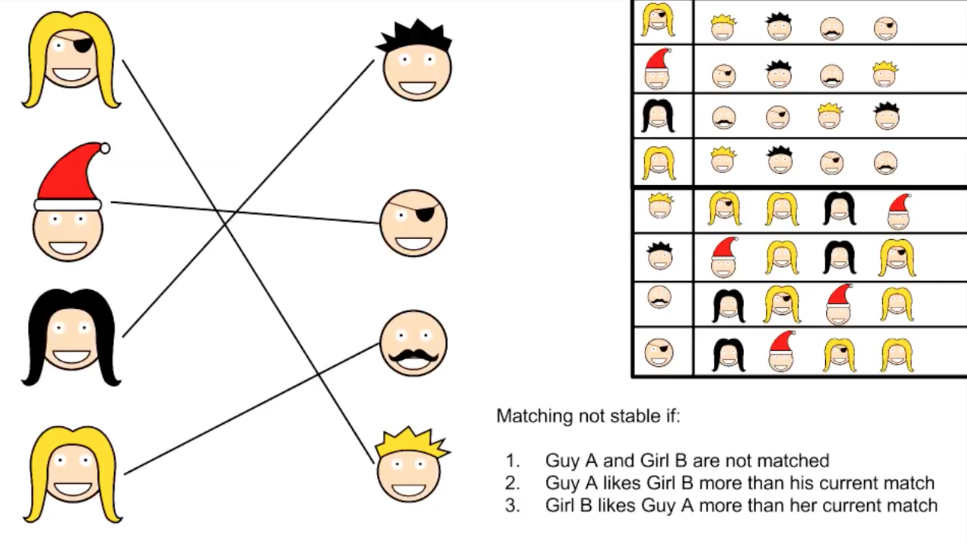
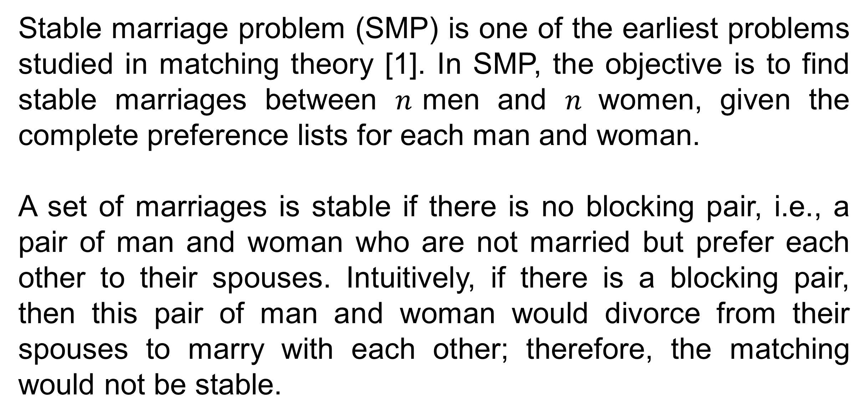
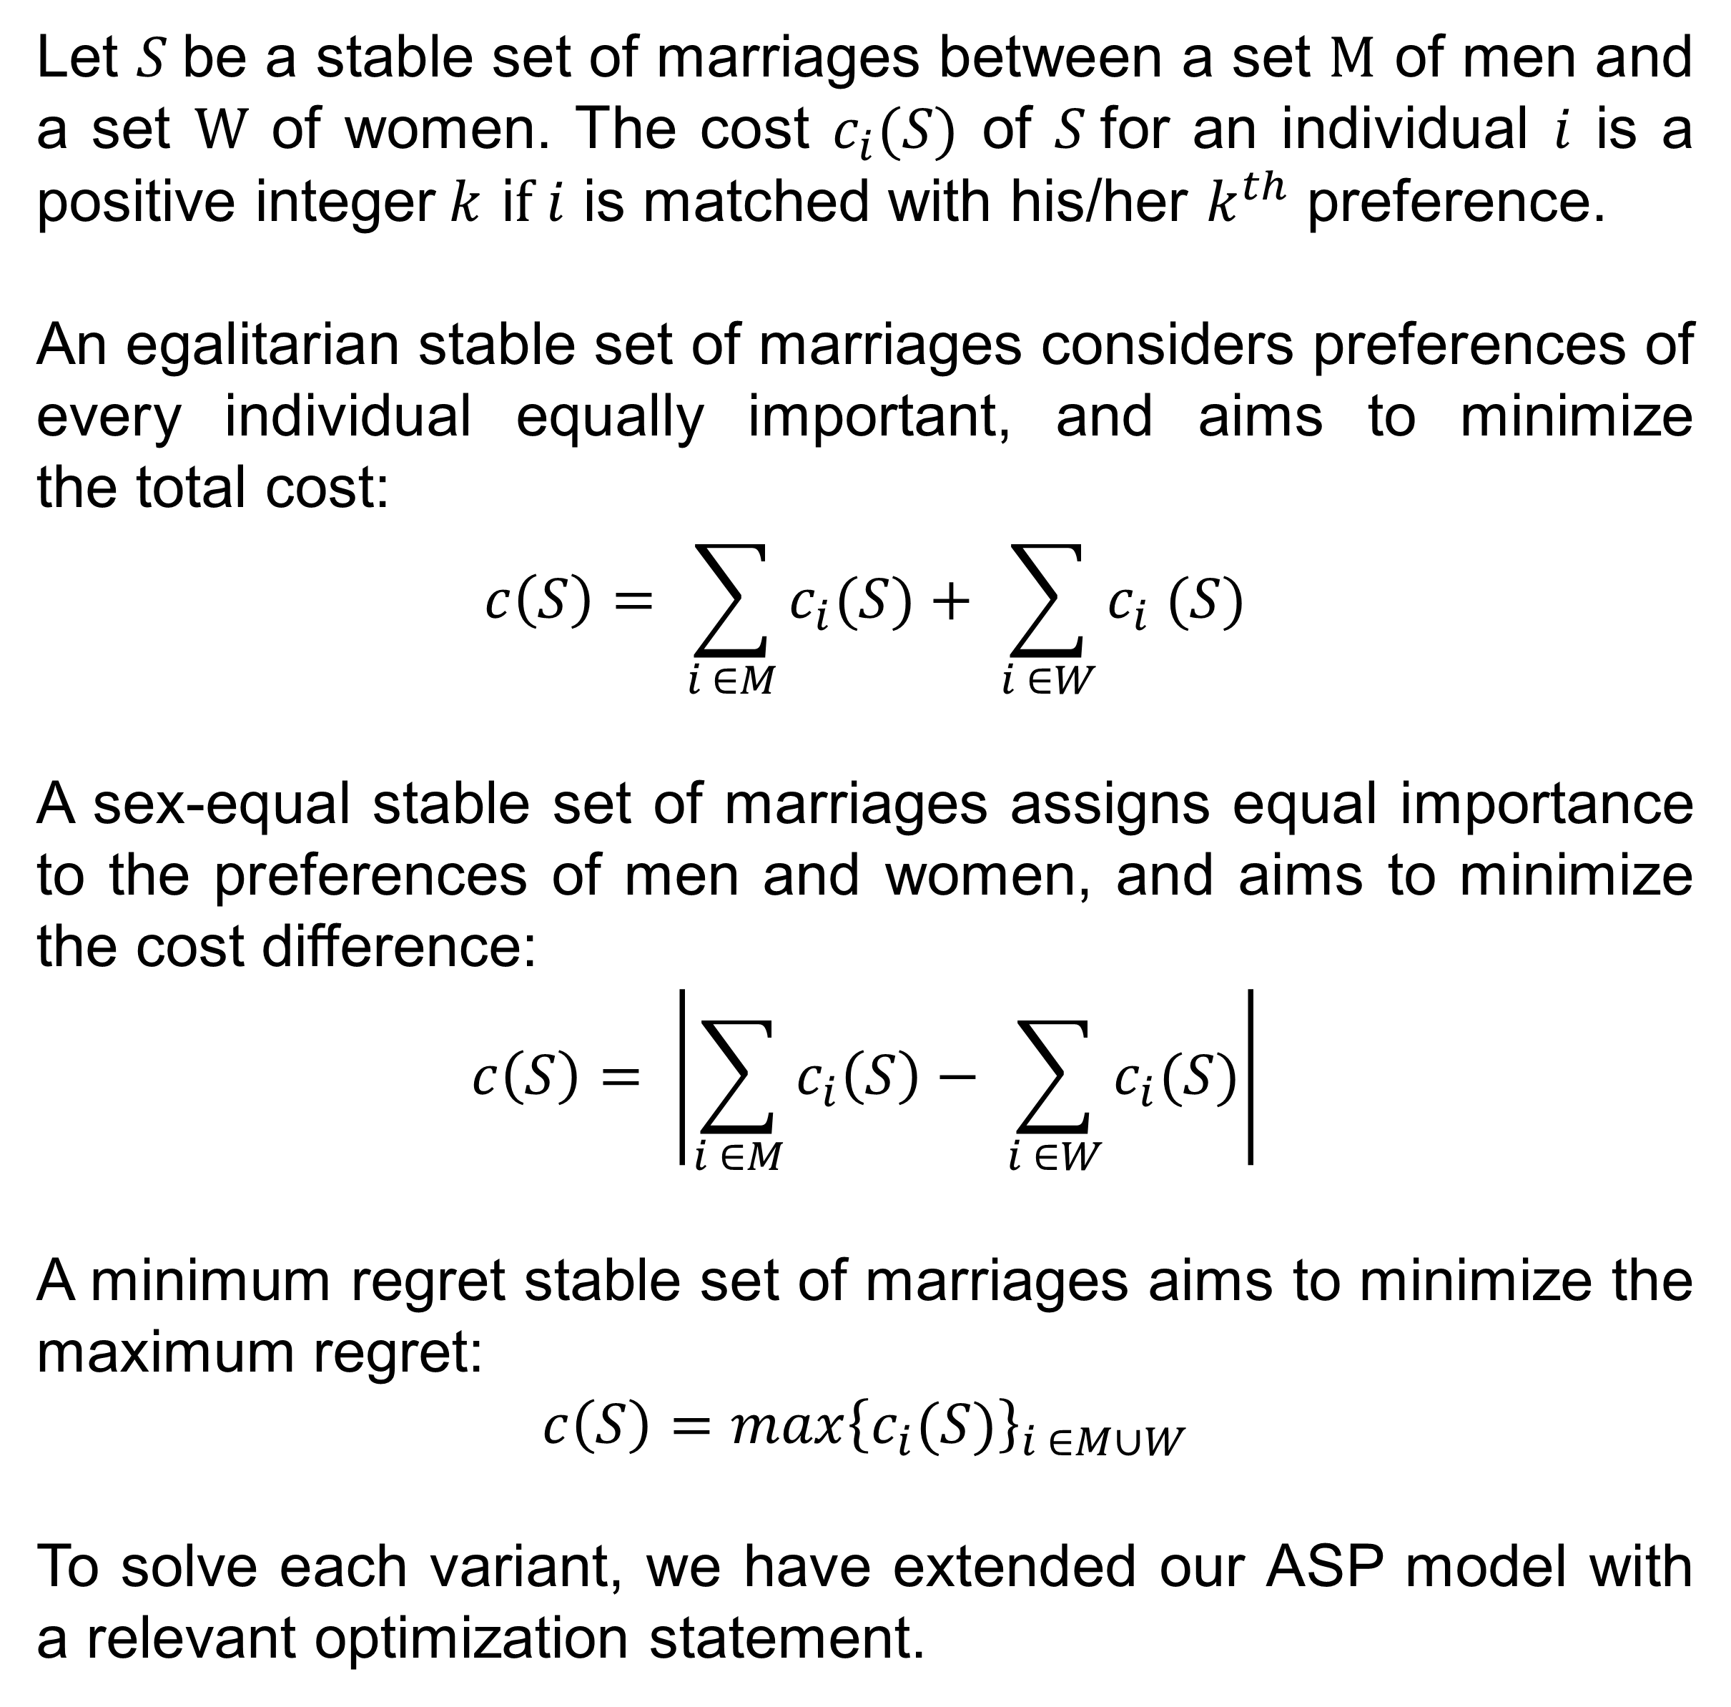
Solving Stable Marriage Problems using Answer Set Programming
Berkan Teber, Özgün Özerk, Selin Eyüpoğlu, Talha Şamil Çakır, Zeynep Melis Meriç
Supervised by Ahmet Alkan and Esra Erdem
Abstract
SMP with Unacceptability and Ties (SMPTI)
Matching problems are about markets where individuals are matched with individuals or firms or items, typically across two sides, as in employment (e.g., who works at which job), university entrance (e.g., which students go to which school), and kidney donation (e.g., who receives which transplantable organ).
In this project, we have studied a matching problem, called Stable Marriage Problem, and its variants. We have introduced a generic method to solve them using an Artificial Intelligence paradigm, called Answer Set Programming.
Stable marriage problem with unacceptability and ties (SMPTI) is a variant of SMP, where
there can be different numbers of men, and
the preferences of men and women do not have to be complete and may include ties.
As a result, in SMPTI, some men and women may be single.
In SMPTI, a pair of man and woman is a blocking pair if they are not married and each of them is either single and finds the other one acceptable, or married and prefers the other one to his/her actual partner.
To solve SMPTI, we have extended our ASP model with a definition of acceptability, and added relevant constraints to avoid blocking pairs.
Stable Marriage Problem (SMP)
Stable marriage problem (SMP) is one of the earliest problems studied in matching theory [1]. In SMP, the objective is to find stable marriages between $n$men and $n$women, given the complete preference lists for each man and woman.
A set of marriages is stable if there is no blocking pair, i.e., a pair of man and woman who are not married but prefer each other to their spouses. Intuitively, if there is a blocking pair, then this pair of man and woman would divorce from their spouses to marry with each other; therefore, the matching would not be stable.
Optimization Variants
Let $S$be a stable set of marriages between a set M of men and a set W of women. The cost $c_{i}(S)$ of $S$for an individual $i$ is a positive integer$k$ i$f i$ is matched with his/her $k^{th}$ preference.
An egalitarian stable set of marriages considers preferences of every individual equally important, and aims to minimize the total cost:
$$c\left(S\right)= \sum_{i ∈M}{c_{i}(S)}+ \sum_{i ∈W}{c_{i} (S)}$$
A sex-equal stable set of marriages assigns equal importance to the preferences of men and women, and aims to minimize the cost difference:
$$c\left(S\right)= \left|\sum_{i ∈M}{c_{i}\left(S\right)− \sum_{i ∈W}{c_{i}(S)}}\right|$$
A minimum regret stable set of marriages aims to minimize the maximum regret:
$$c\left(S\right)=max{\left\{c_{i}(S)\right\}}_{i ∈M∪W}$$
To solve each variant, we have extended our ASP model with a relevant optimization statement.
Source: https://www.youtube.com/watch?v=Dm7OQr53xKY
Solving SMP in Answer Set Programming
We have modeled SMP in Answer Set Programming (ASP) [2] and used the ASP solver Clingo [3] to compute solutions:
% GENERATE −− generate a matching
{marry(M,F): woman(F)} = 1 :− man(M).
:− {marry(M,F): man(M)} > 1, woman(F).
% DEFINE –- define preferences qualitatively
mprefer(M,DF,CF) :− mpref(M,CF,CUR),
mpref(M,DF,DEV), DEV < CUR.
wprefer(F,DM,CM) :− wpref(F,CM,CUR),
wpref(F,DM,DEV), DEV < CUR.
% TEST – ensure nonexistence of a blocking pair
:− marry(M1,F1), marry(M2,F2),
mprefer(M1,F2,F1), wprefer(F2,M1,M2),
man(M1;M2), woman(F1;F2).
Conclusions
We have introduced a novel solution for SMP and its variants, using ASP. We will continue our studies with the evaluation of our methods, and investigation of other matching problems.
References
Gale, D., & Shapley, L. (1962). College Admissions and the Stability of Marriage. The American Mathematical Monthly, 69(1), 9-15.
Gelfond, M., & Lifschitz, V. (1988). The stable model semantics for logic programming. In Proc. of ICLP.
Gebser, M., Kaminski, R., Kaufmann, B., & Schaub, T. (2014). Clingo = ASP + Control: Preliminary Report. In Proc. of ICLP.

